Slide 1
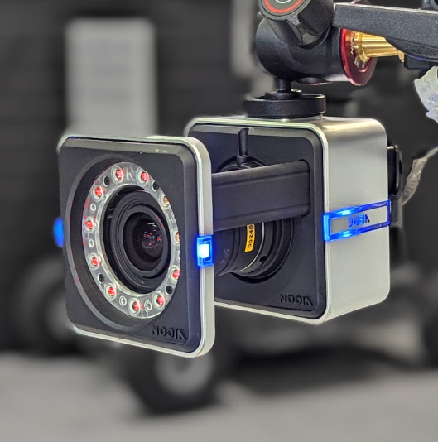
FGCT5004:
Motion Capture Technologies
University for the Creative Arts

Slide 2
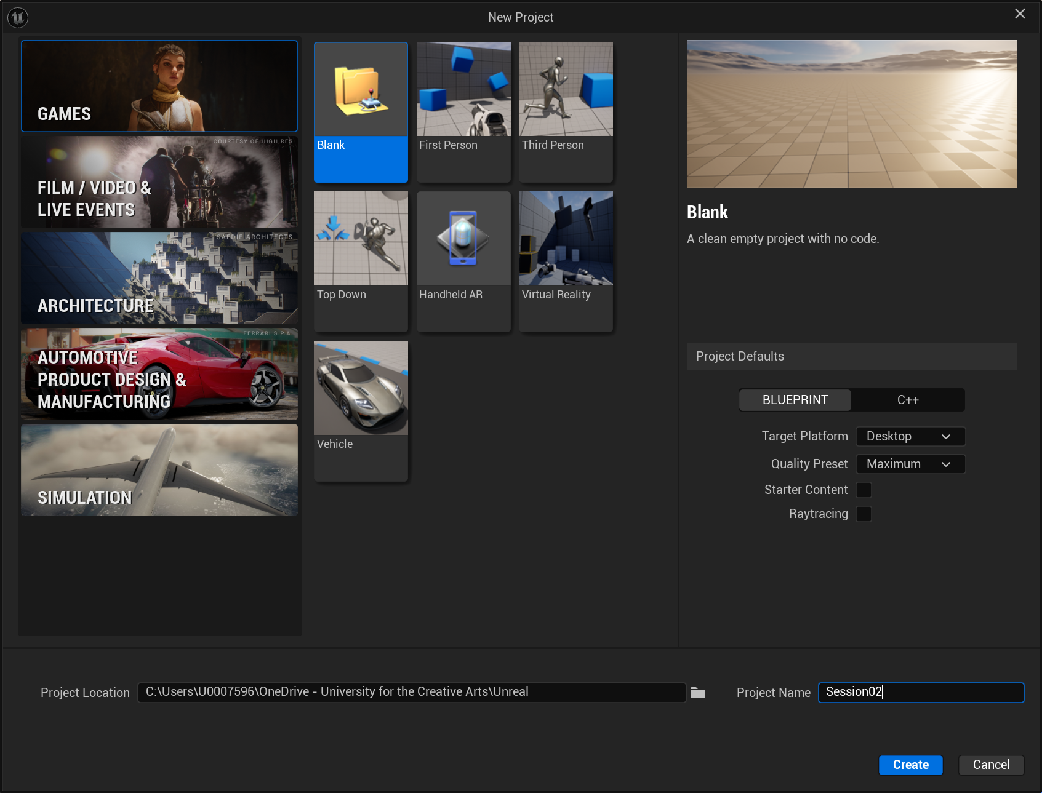
Before we start:
Please load up Unreal and create a blank project!
The first time you do this when you log into a computer it takes a looooooonnng time to load.

Slide 3
Lesson Aims
In todays session we will explore how to do these in Unreal:
Importing Metahumans.
Importing mocap studio animations.
Retargeting the mocap animations to the Metahumans.
Playing the animations with the sequencer.

Slide 4
Lesson Plan
Load up Unreal and create a blank project! (it takes about 10min start up)
Demo customising Metahumans
Start importing Metahumans to Unreal with Quixel Bridge (takes about 20min to download)
Using Motion Builder to prepare fbx files
Opening files
Clean Scene
Adding Cube object
Exporting character
Finish importing Metahumans to Unreal with Quixel Bridge.
Preparing additional animations in Motion Builder (ie no need to attach cube)
Importing mocap into Unreal (first time)
Importing additional animations into Unreal (attach to original skeleton)
Retargeting Animations to Metahumans
Sequencer

Slide 5
Importing
Metahumans to Unreal

Slide 6
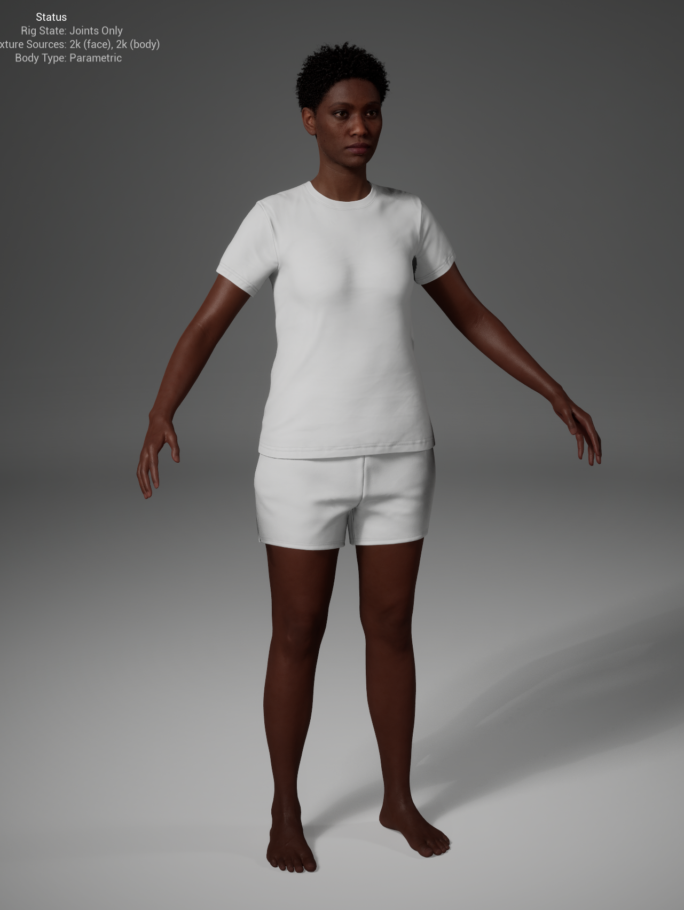
Important
The new Metahuman setup in Unreal 5.6 provides a lot more customisation in terms of body types etc – however, there is one big drawback - they don’t come with any clothing options.
For this reason, we’re going to be using the old method of using the Quixel Bridge to import them, and the online Metahuman Creator if you wish to customize them.

Slide 7
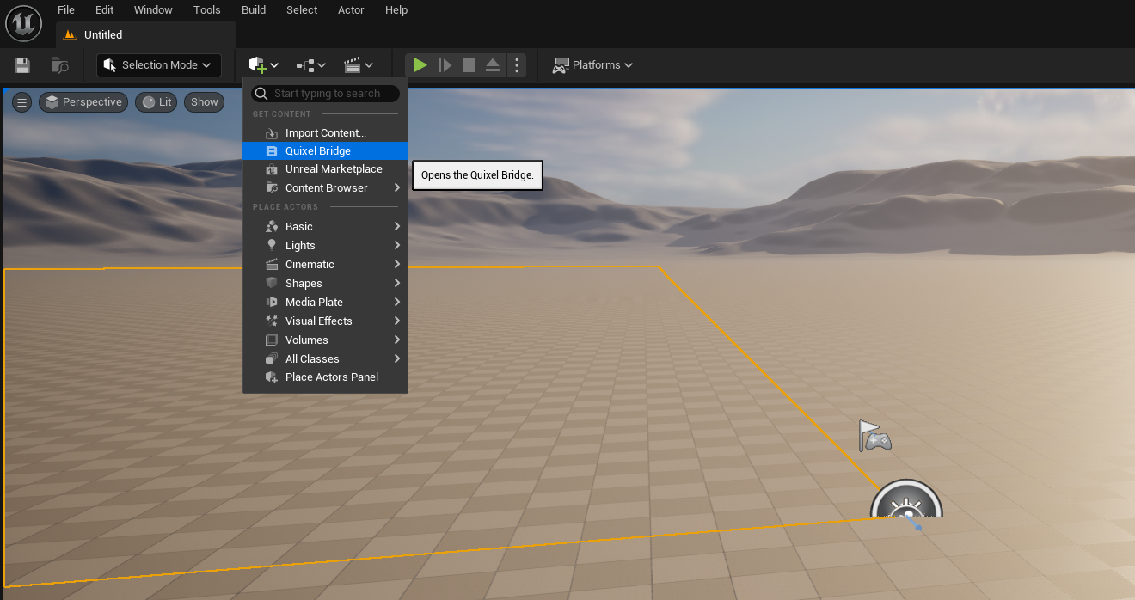
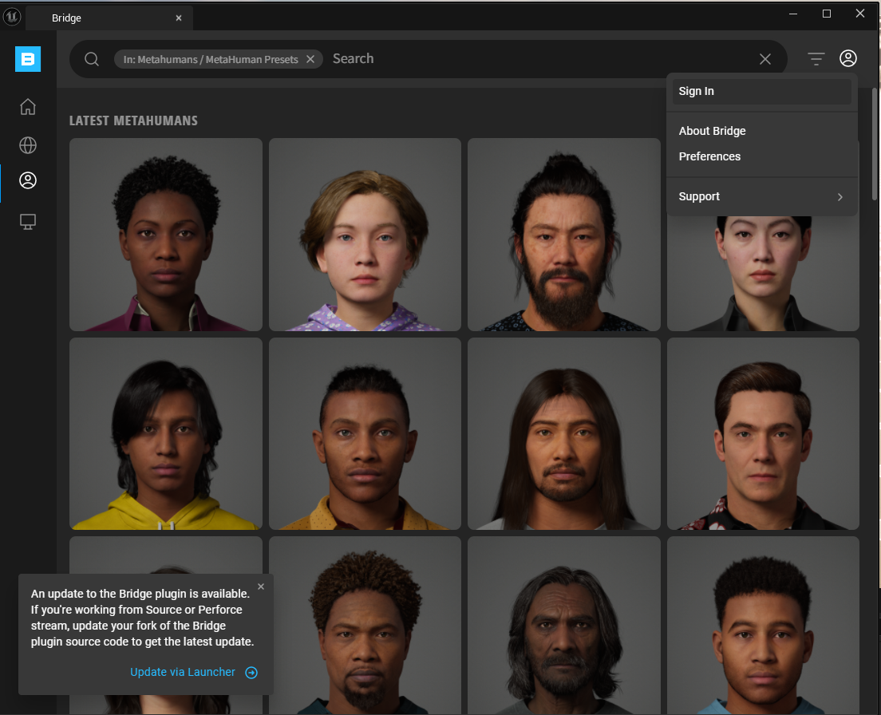
Importing
Sign in – you may need to do this twice to get it to actually work!
Open Quixel Bridge

Slide 8
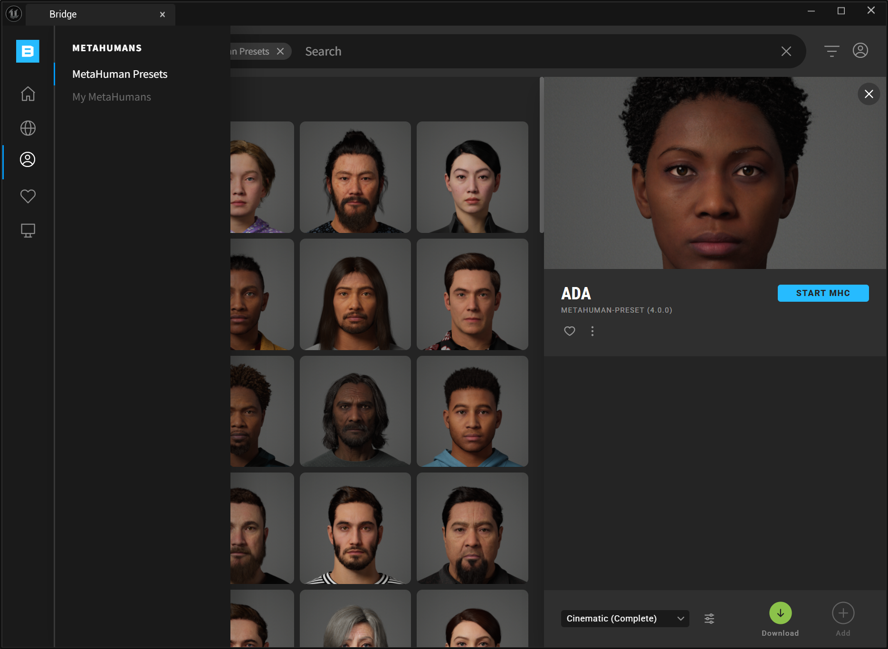
2. Select the MetaHuman Presets
1.
5. Click Download (this may take about 10 mins or more)
4. Select Cinematic (Complete) quality
Apparantly it needs to be this setting for the old Metahumans to work correctly with the new setup
6. Click Add, to import the Metahuman into your current project.
3. Choose your MataHuman

Slide 9
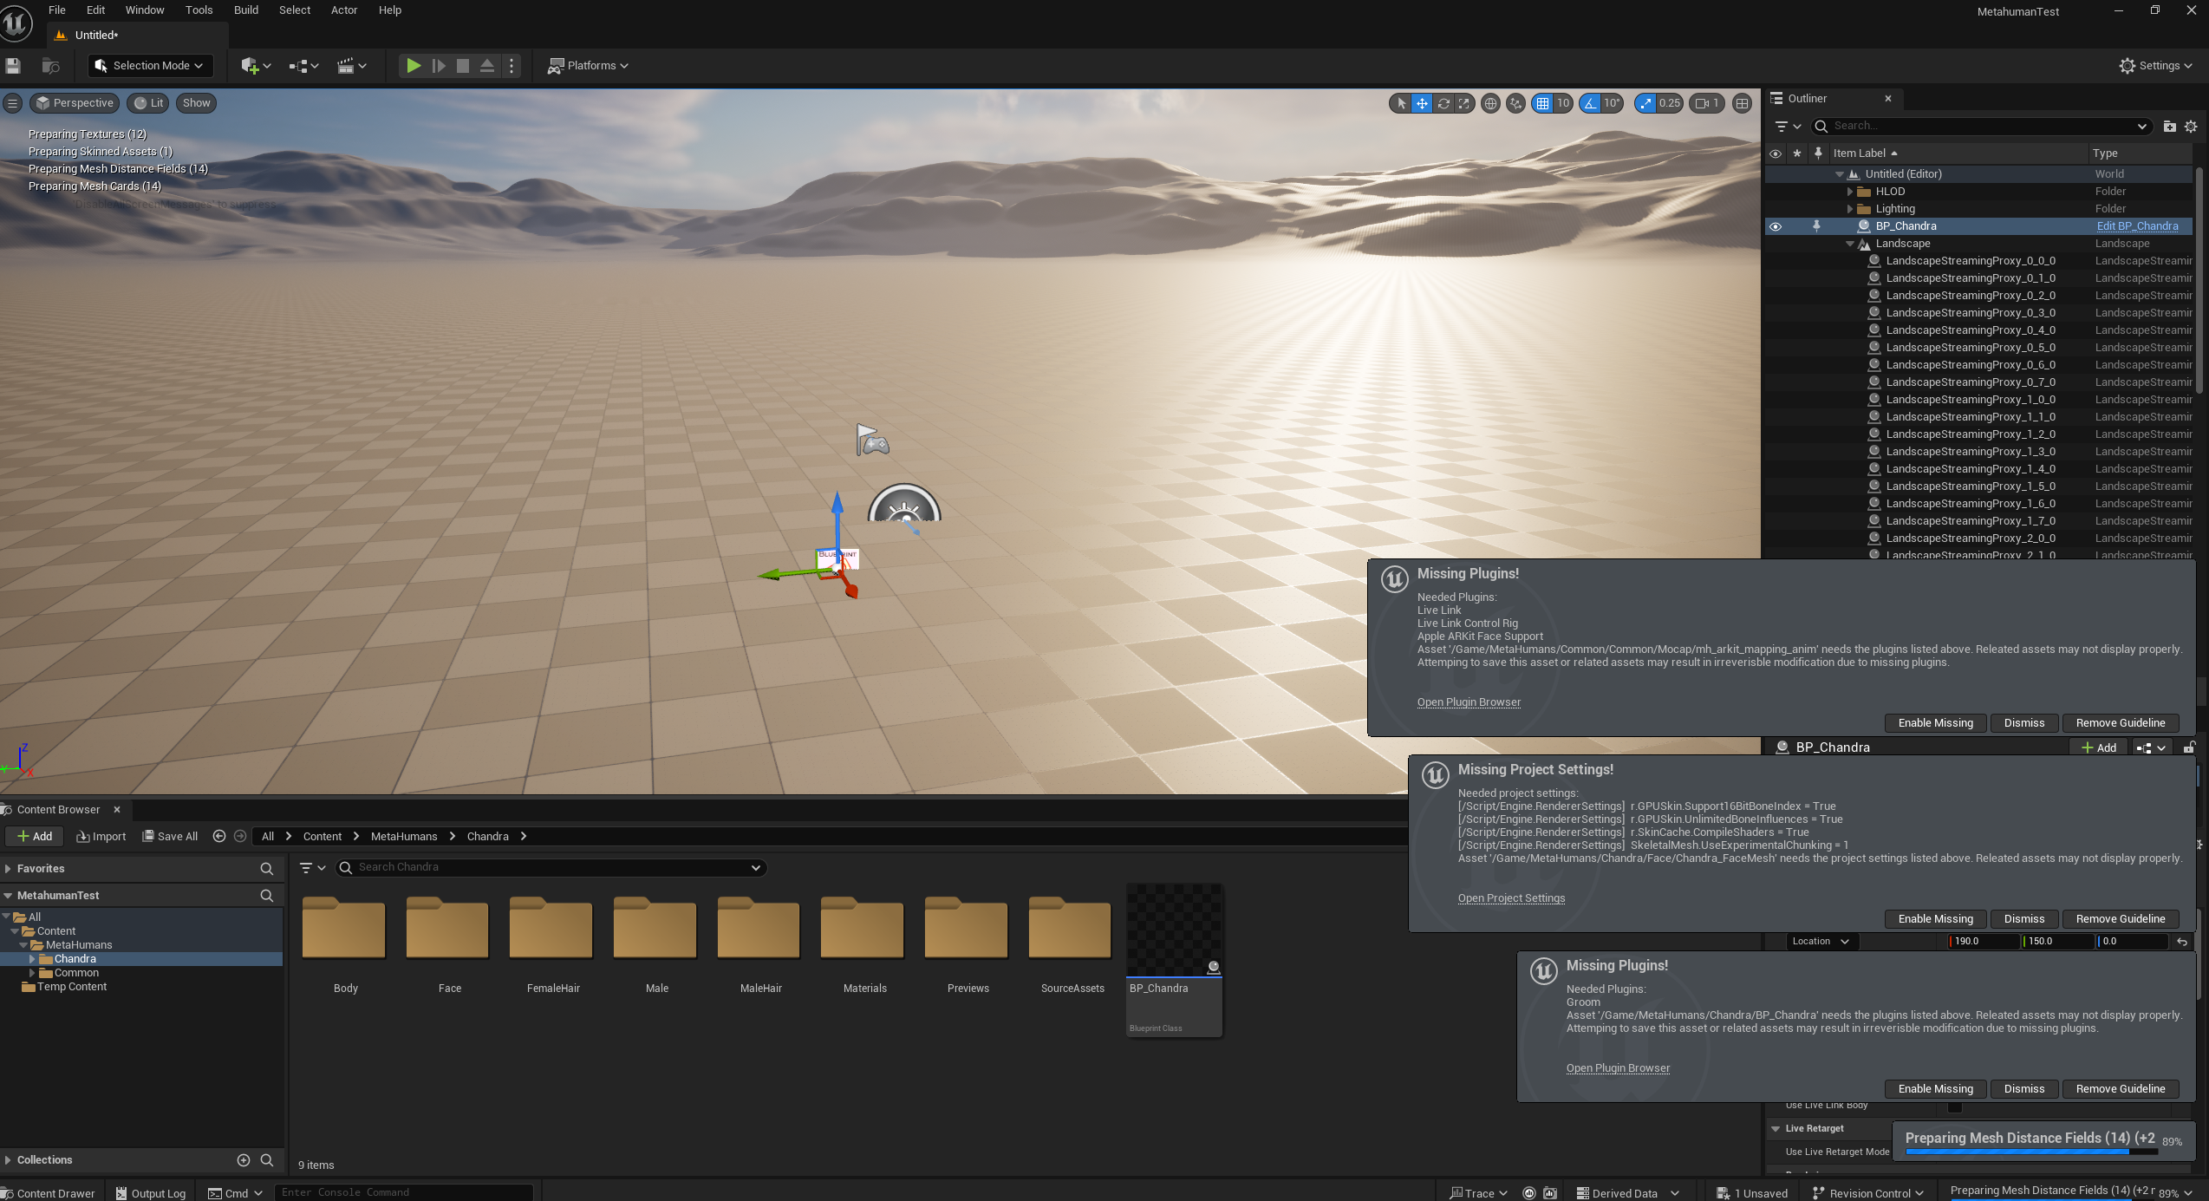
MetaHumans
Drag your character’s Blueprint into the level.
You’ll then need to Enable Missing plugins and restart the project
Note: upon restarting you may need to wait a long time for the project to reload while it compiles the shaders.
Navigate to your character’s folder

Slide 10
Metahuman Creator

Slide 11
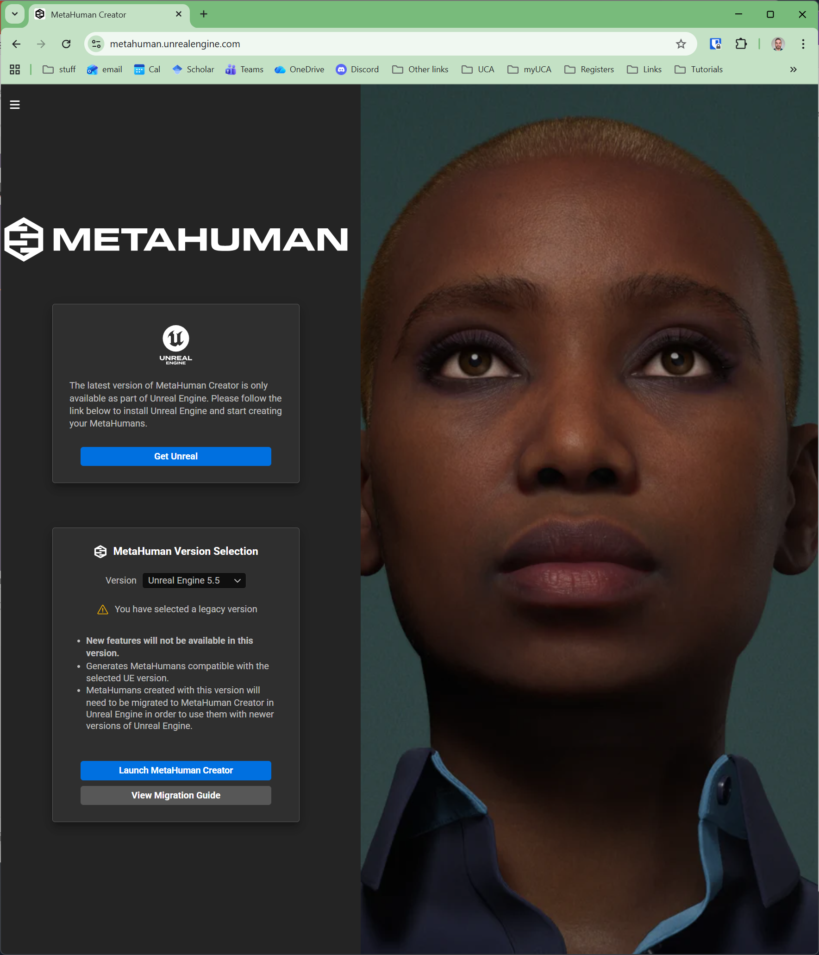
MetaHuman Creator
Go to…
https://metahuman.unrealengine.com/
Click to launch - it can take a long time to load!

Slide 12
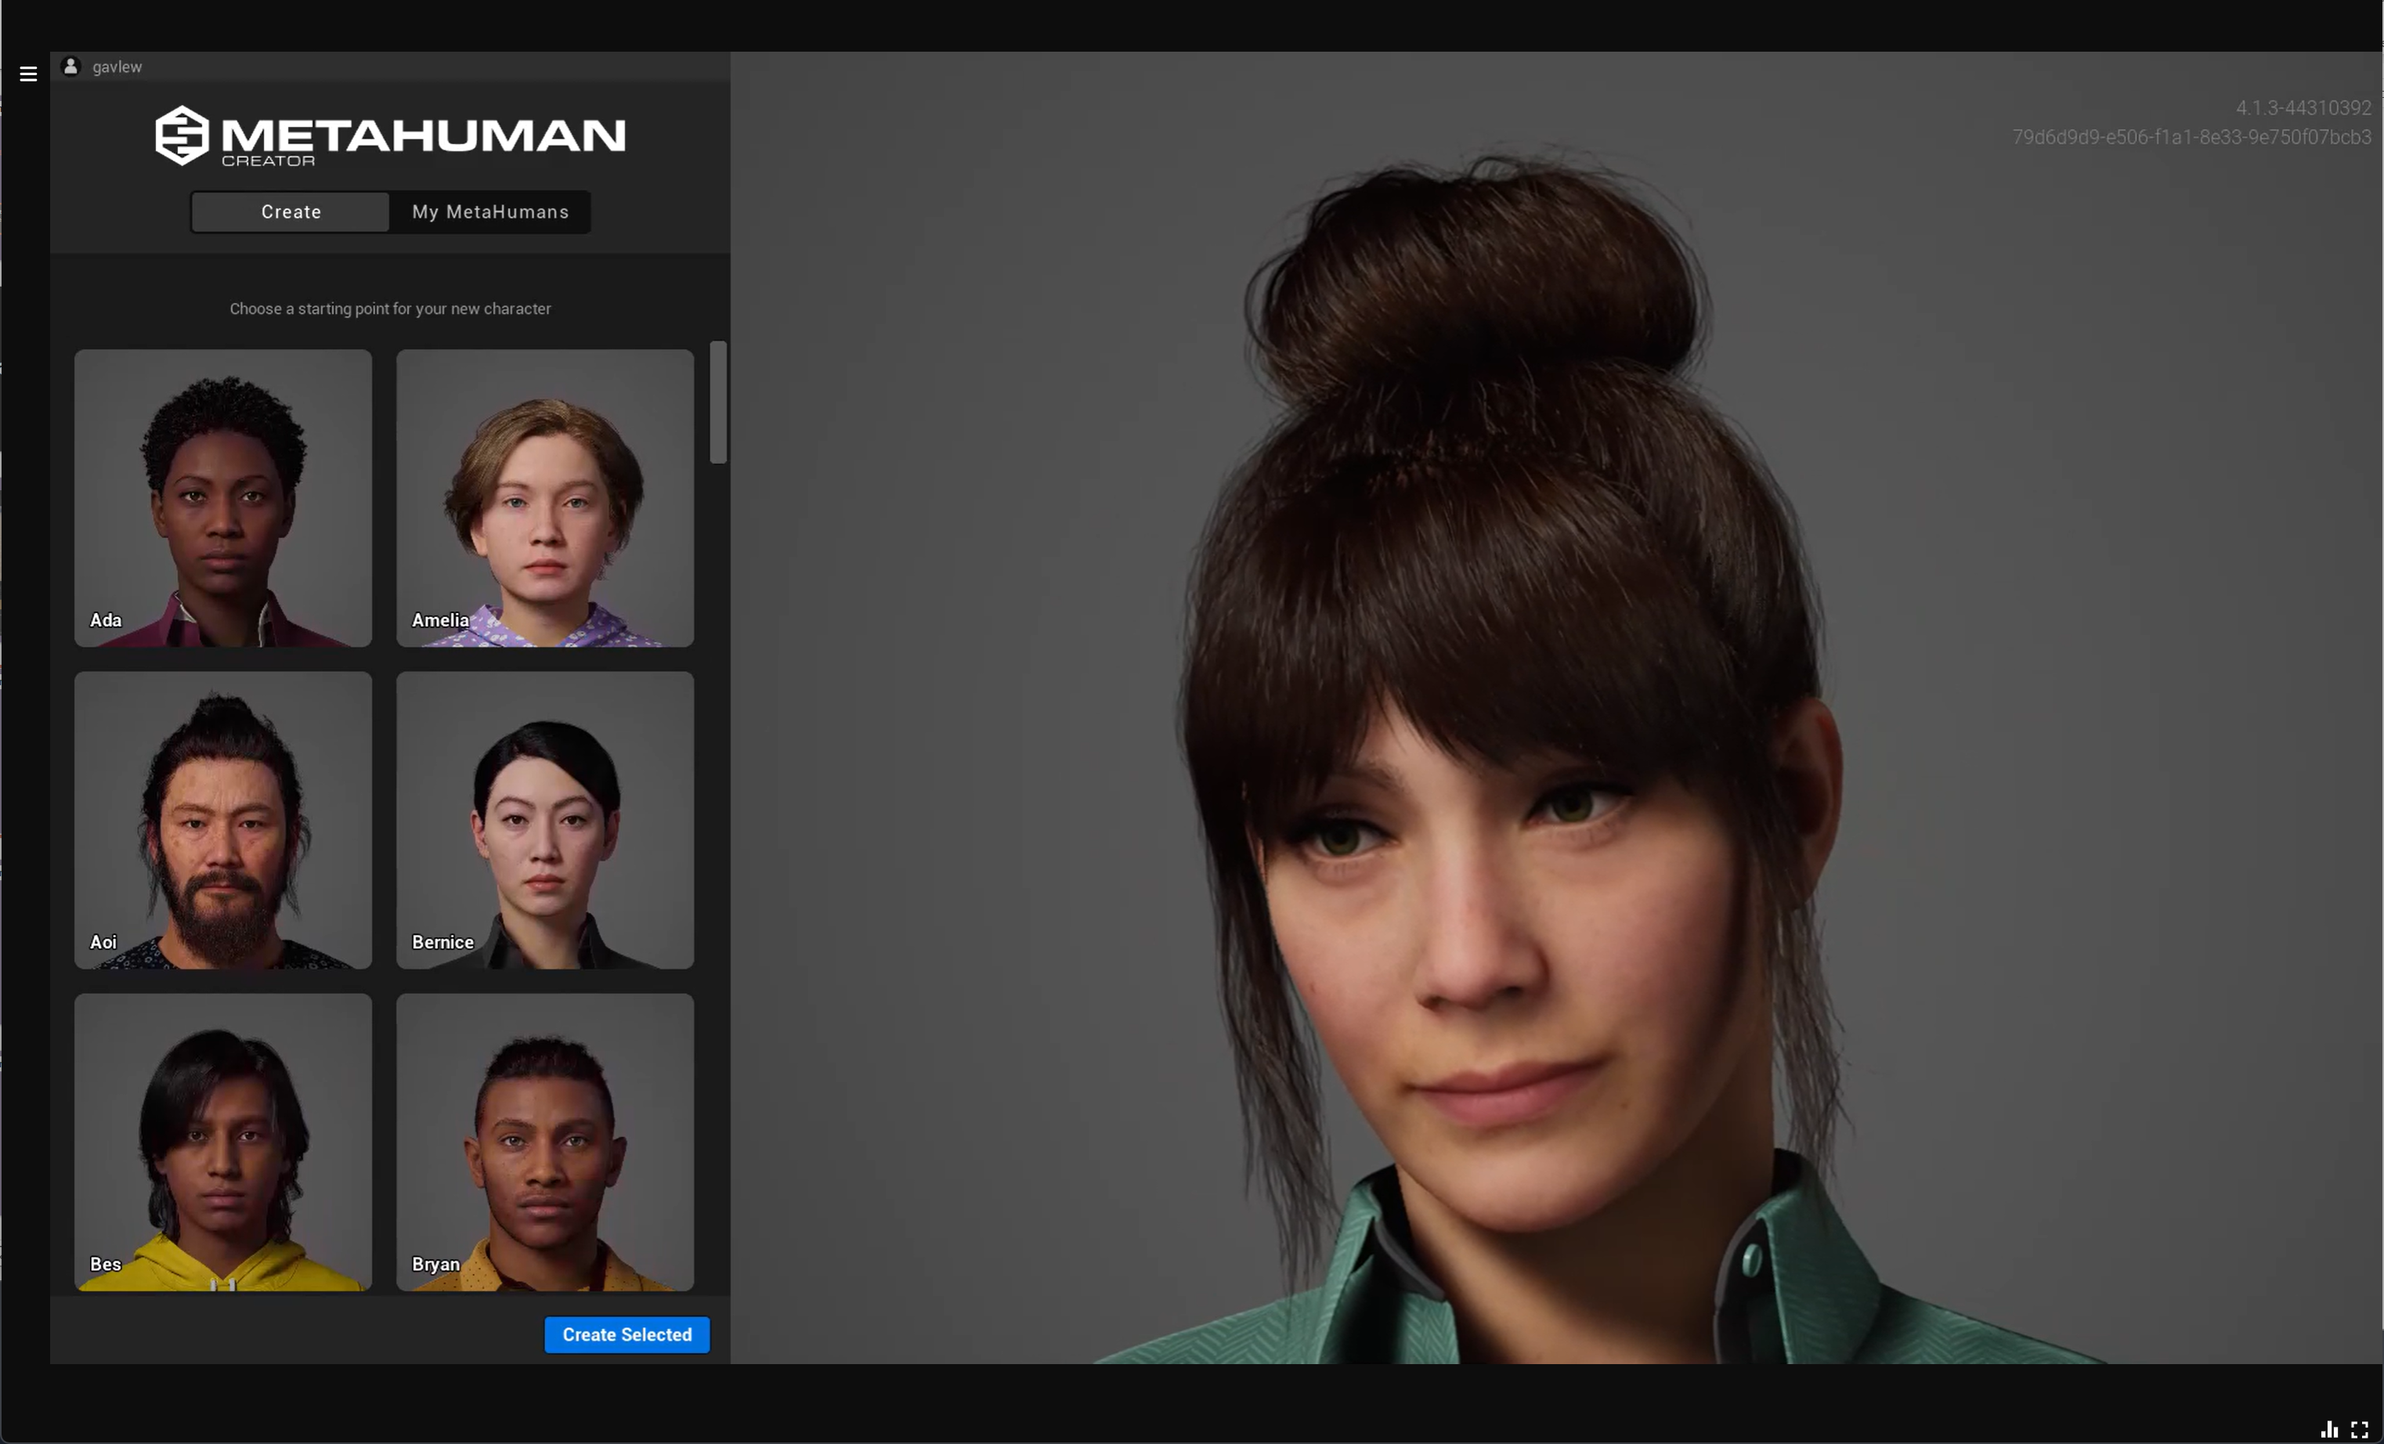
MetaHuman Creator
Choose a starting point for your character, then click Create Selected

Slide 13
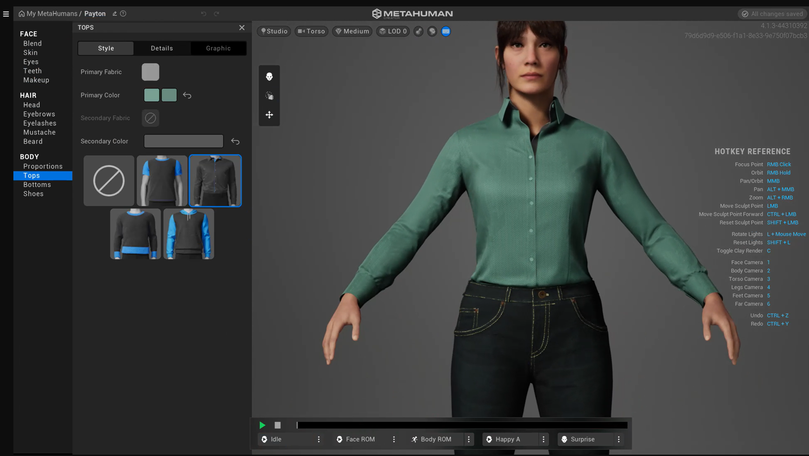
You can choose the categories to adjust here

Slide 14
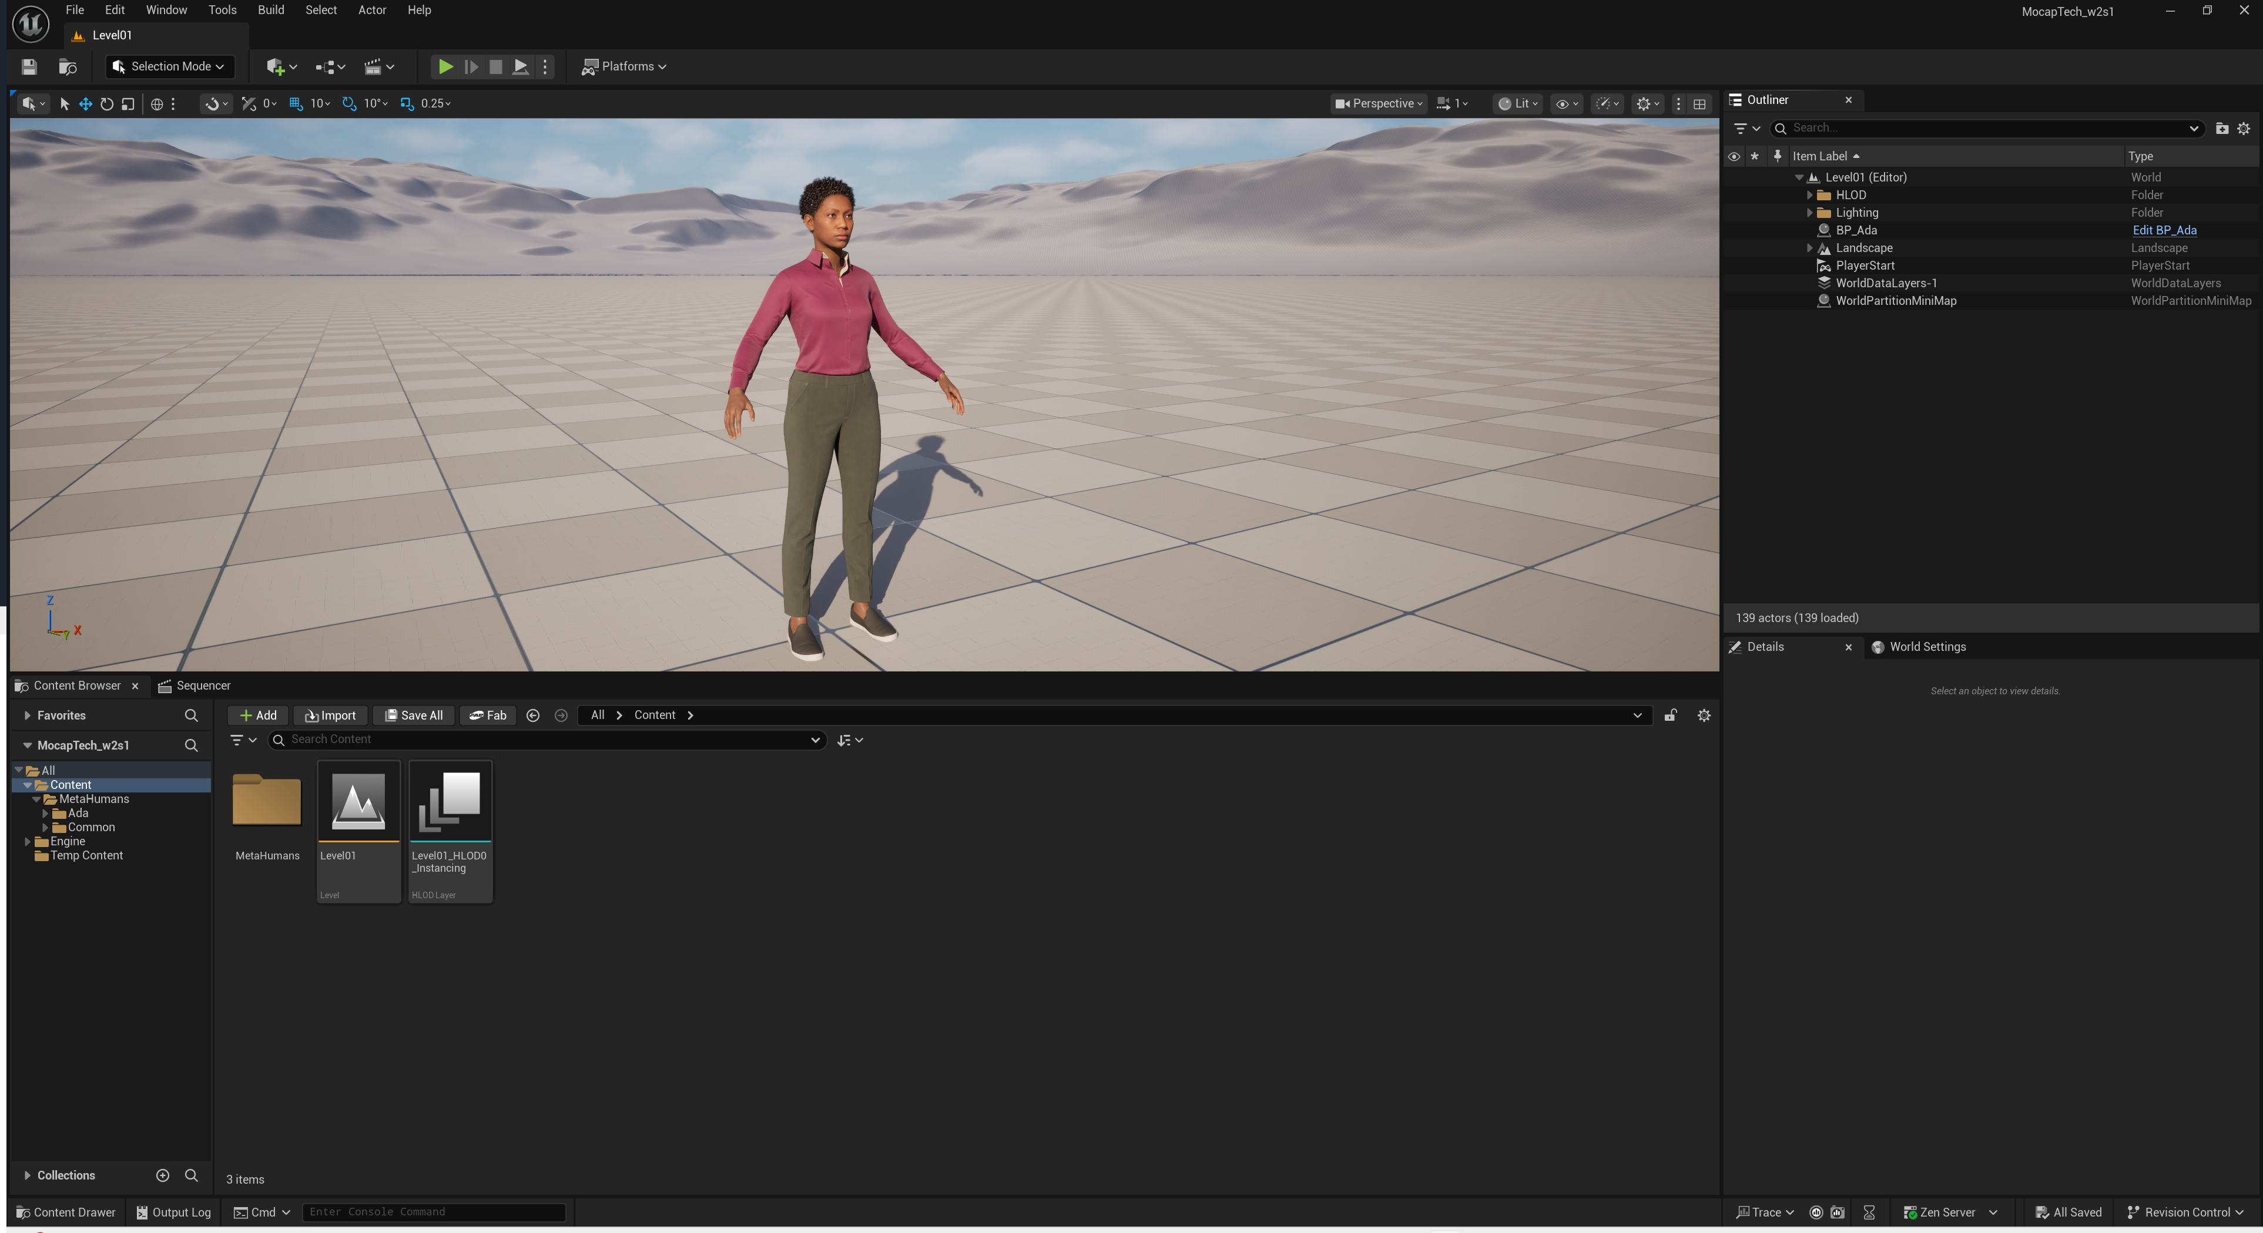
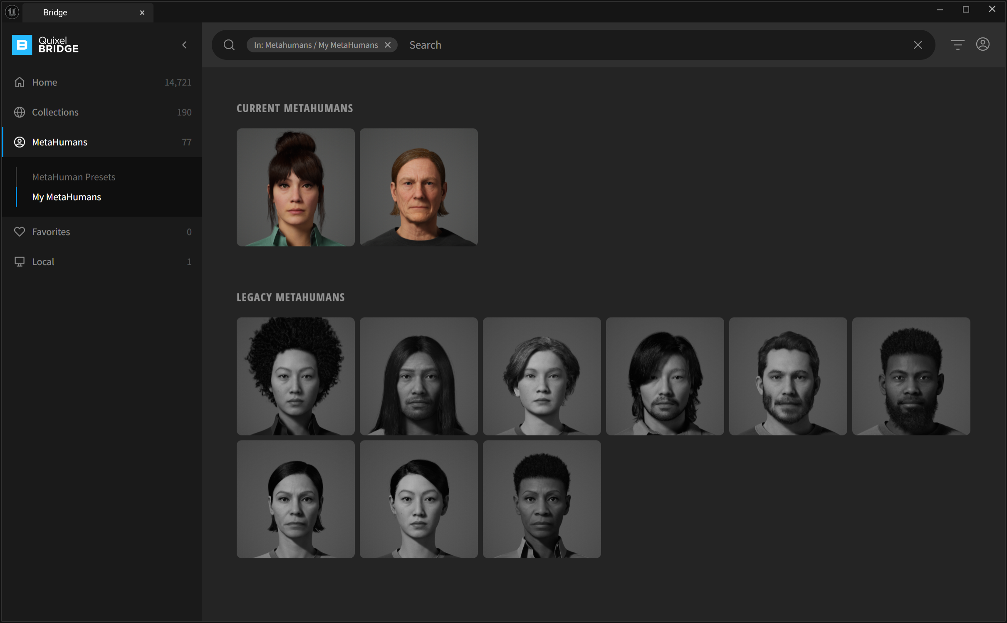
MetaHuman Creator
Now, return to the Quixel Bridge in Unreal, and in the My MetaHumans section you should see your new MetaHuman ready to import.
Note: if you don’t see the My MetaHuman section make sure you are signed in to the Bridge.

Slide 15
Importing Animations into Unreal

Slide 16
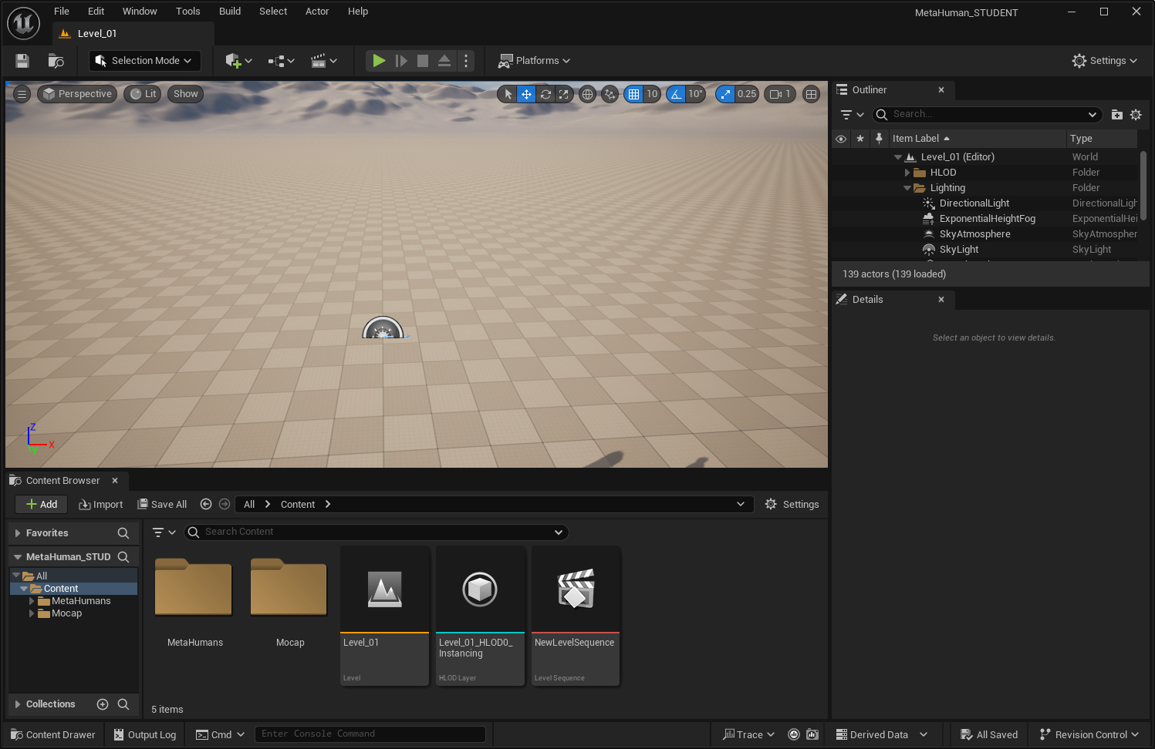
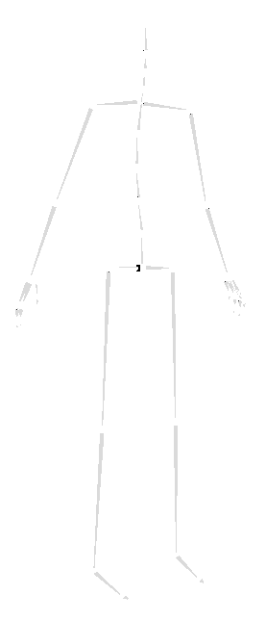
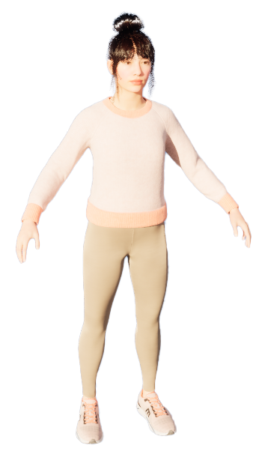
Overview
Retarget

Slide 17
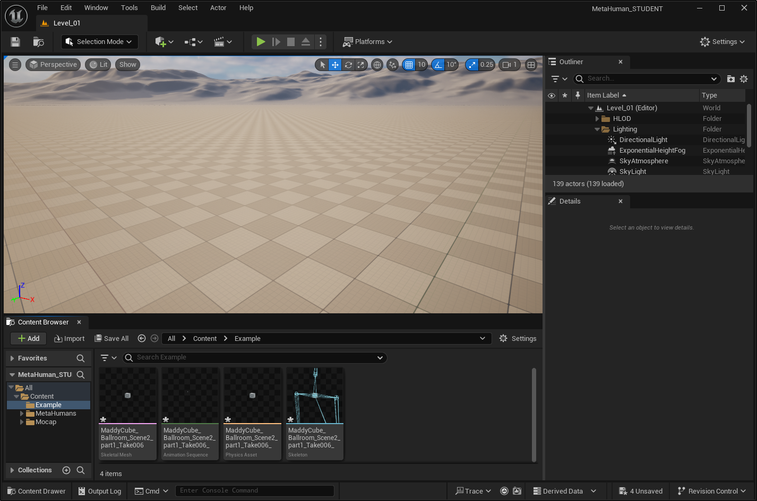
First Time import mocap skeleton:
Notes:
The first time that we import an fbx file into Unreal it creates these assets.
These include a Skeletal Mesh (which is a Skeleton with a Mesh Attached), and the Animation assets (which contains the animation)
To create the skeletal mesh asset there has to be a mesh attached to the skeleton. Normally that’s not a problem as most skeletons have meshes attached. But when we export from the mocap studio, we only get the skeleton, not a mesh.
If the skeleton does not have a mesh it refuses to import it.
So to trick Unreal we need to attach a mesh before we import it. Then it will allow us to import it.
We only need to do that the first time for each character. So for any additional animations we bring in, we don’t need to attach the cube, and we can tell Unreal to use the skeletal mesh we’ve already brought it (and it will create another animation asset for that skeletal mesh)

Slide 18
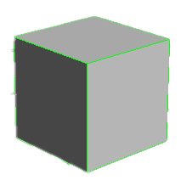
First Time import mocap skeleton:

Slide 19
First Time import mocap skeleton:
✔

Slide 20
Extra animations for same character:
✔

Slide 21
Preparing FBX files

Slide 22
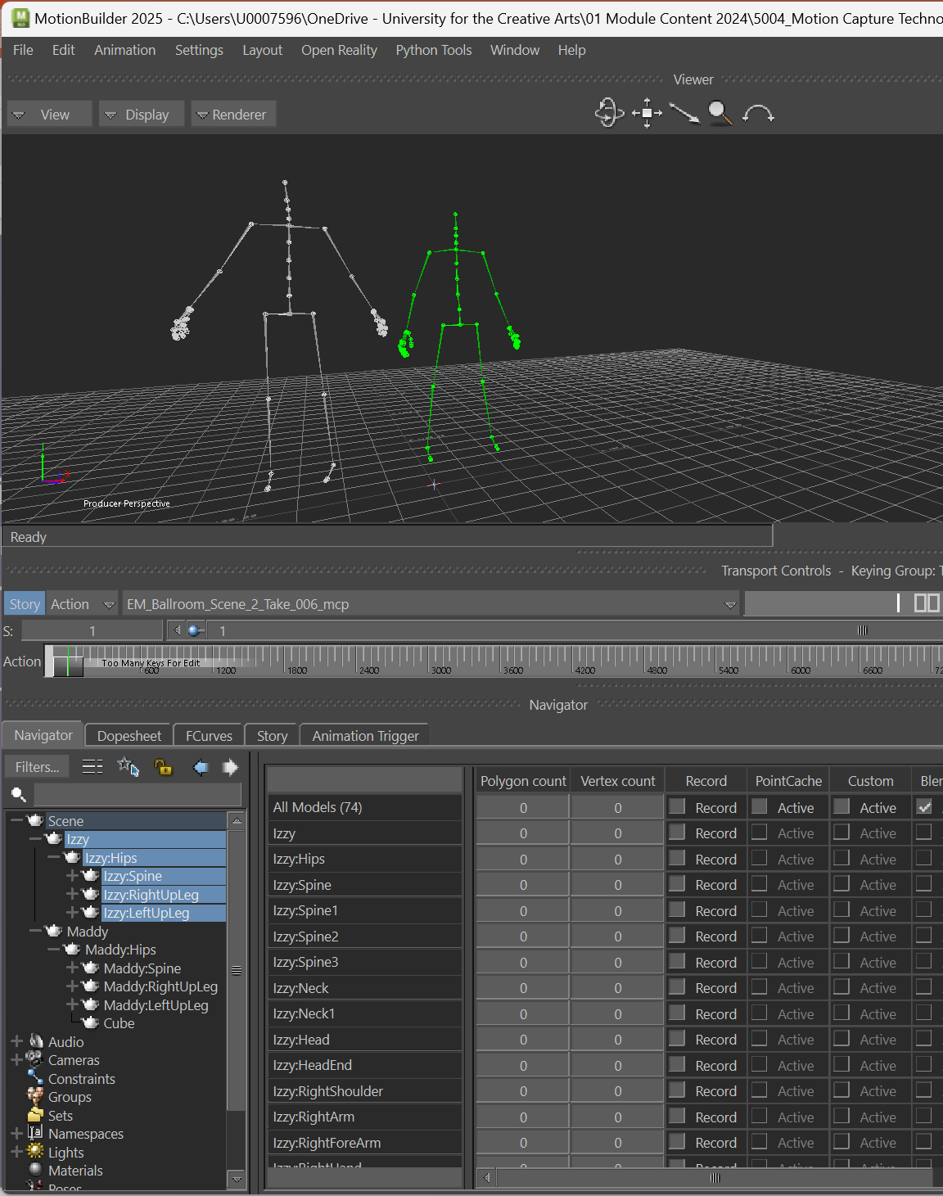
Preparing FBX files
Before we import the mocap animation into Unreal, we need to do two things:
Separate out the skeletons to have one per file.
Attach a mesh to each character (can be just a cube)

Slide 23
Preparing FBX files
Before we import the mocap animation into Unreal, we need to do two things:
Separate out the skeletons to have one per file.
Attach a mesh to each character (can be just a cube)
Important! We only need to attach the mesh the first time we import a skeleton into Unreal.
For any additional animations we just need to separate out the skeletons to have one per file (but the mesh is not needed)

Slide 24
Preparing FBX files
(First Time)

Slide 25
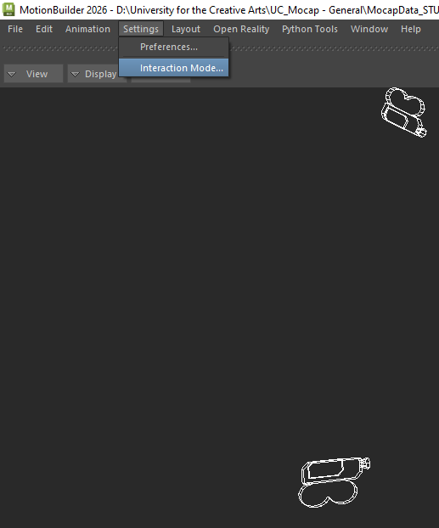
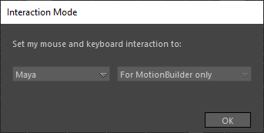
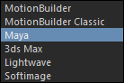
Motion Builder
When you load Motion Builder I’d suggest changing the Interaction Mode to Maya.

Slide 26
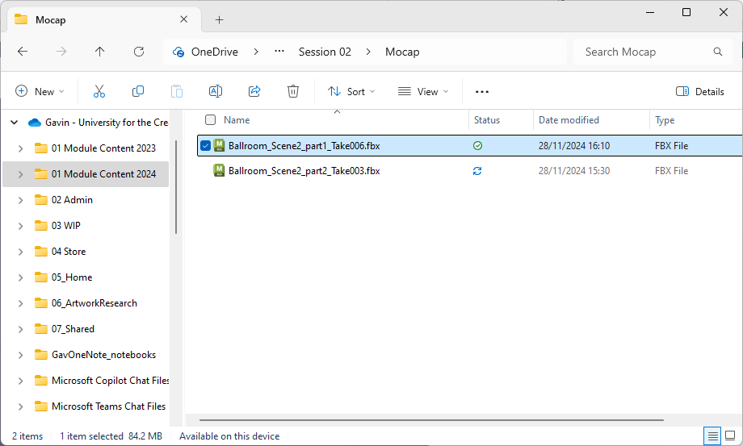
Preparing files (First time)
Gather your motion capture (.fbx) files.

Slide 27
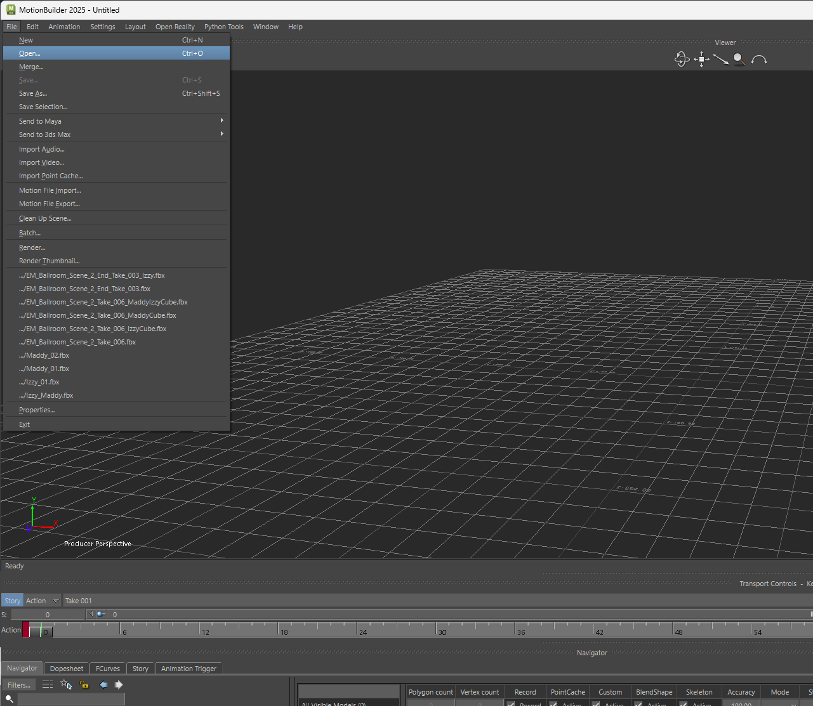
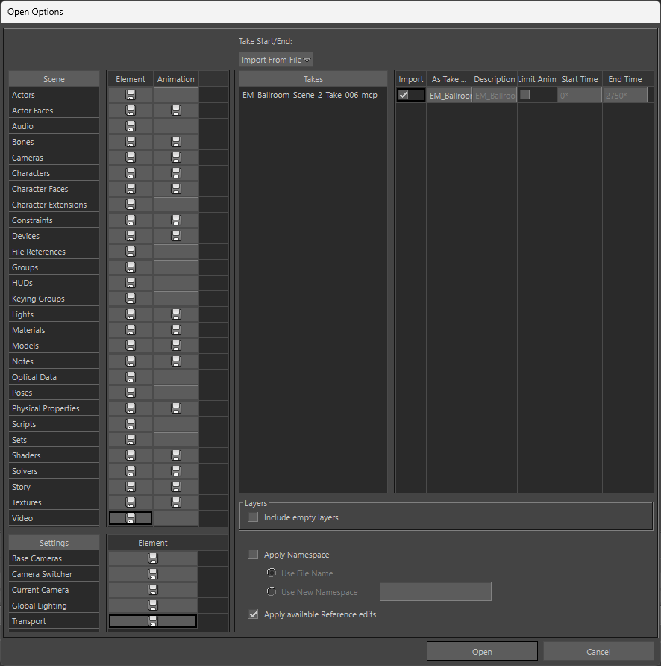
Preparing files
Open one of the files in Motion Builder

Slide 28
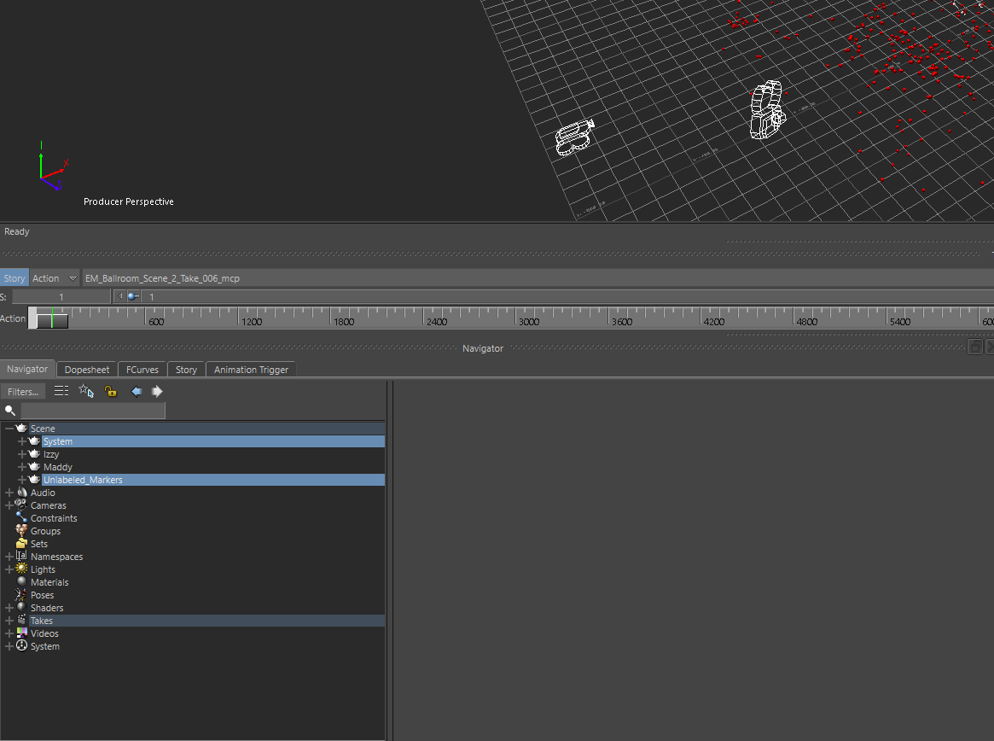
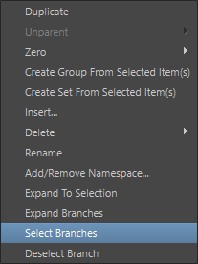
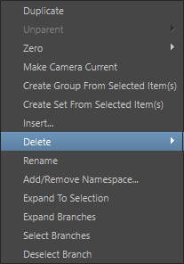
Clean the Scene
Let’s remove the stuff we don’t need:
In the Navigator, select System and Unlabeled_Markers
Right click > Select Branches
Right click > Delete > Confirm

Slide 29
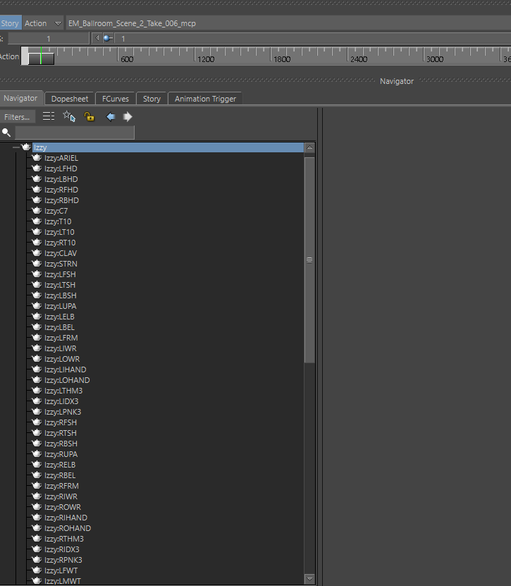
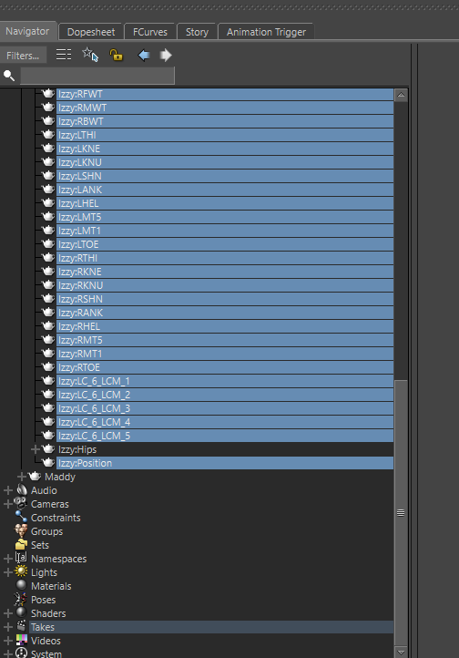
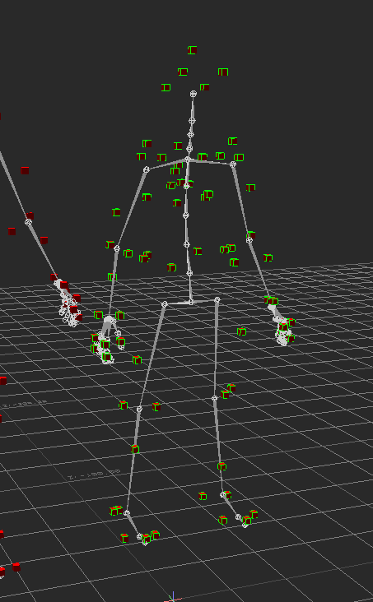
Clean the Scene
For each character:
click the + symbol next to the character name.
Select everything inside, except the Hips object
Right click > Delete > Confirm

Slide 30
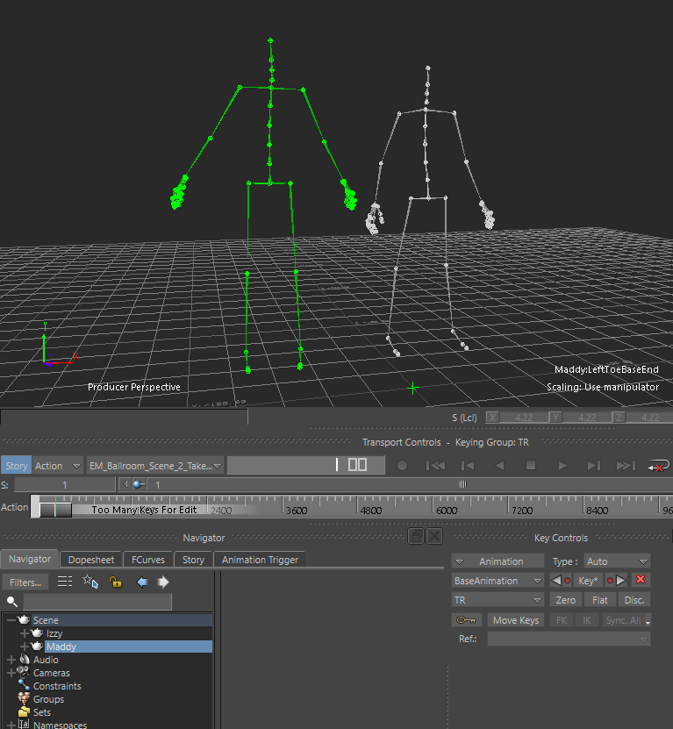
Preparing files
Izzy
Make sure you know which character is which.
You can right click a character in the Navigator, and pick Select Branches to see the character highlighted in the viewport.
Maddy

Slide 31
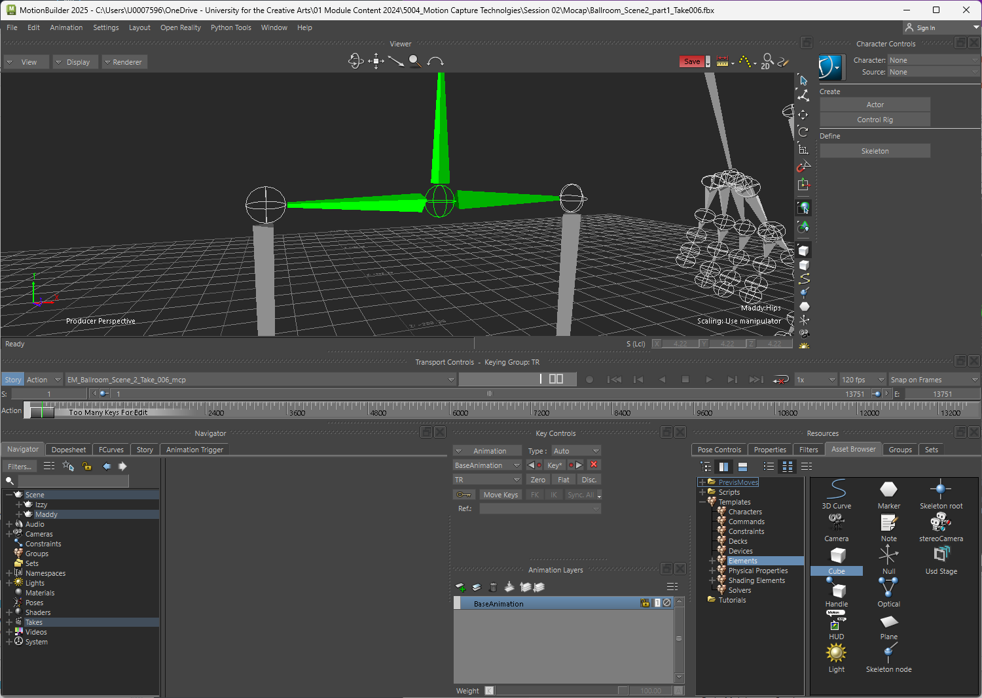
Preparing files
For each character:
Zoom the viewport camera close into the hips.
Drag a Cube out of the Asset Browser and release it over the hips (make sure the hips highlight green before you let go)
This will position the Cube in the same position as the hips.

Slide 32
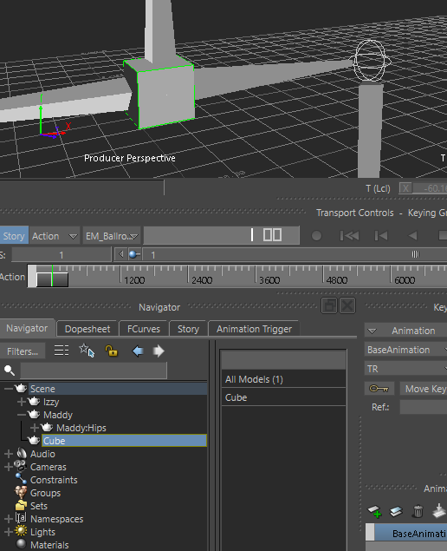
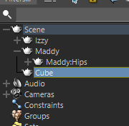
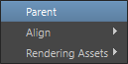
Preparing files
Next, we need to ‘parent’ the cube under the hips in the skeleton hierarchy.
In the navigator, left click and drag the Cube onto the character’s hips.
Select Parent.

Slide 33
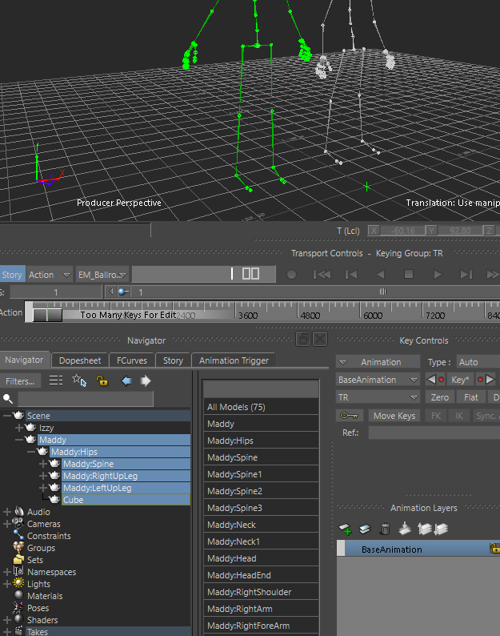
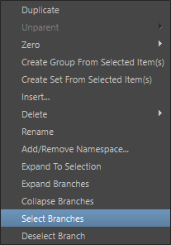
Exporting Characters
Your character is now ready to export. To do this select the very top object for your character in the hierarchy, then right click and Select Branches
You must select the character from the top object in the hierarchy (rather than the hips).

Slide 34
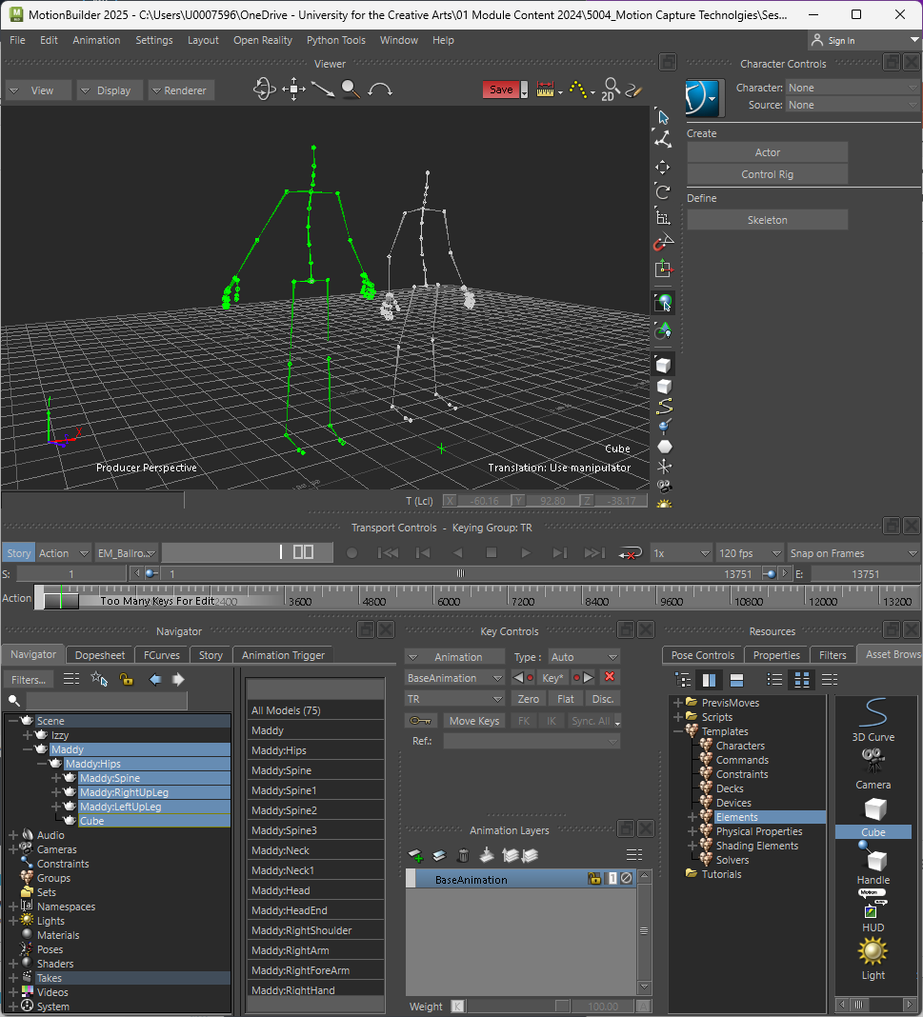
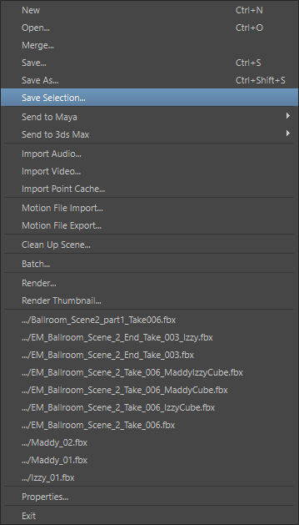
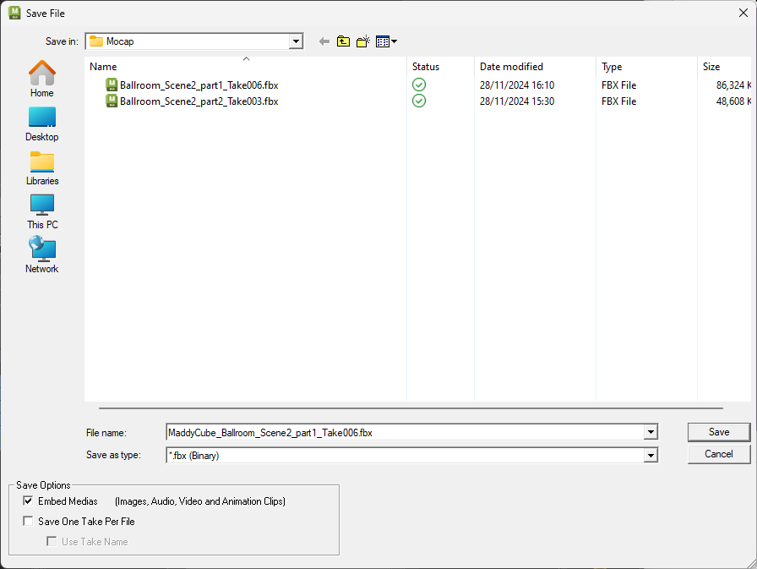
Exporting Characters
File > Save Selection…
I’d recommend prefixing the name with:
CharacterNameCube_
i.e.
MaddyCube_
IzzyCube_
etc

Slide 35
Preparing FBX files
(Additional Animations)

Slide 36
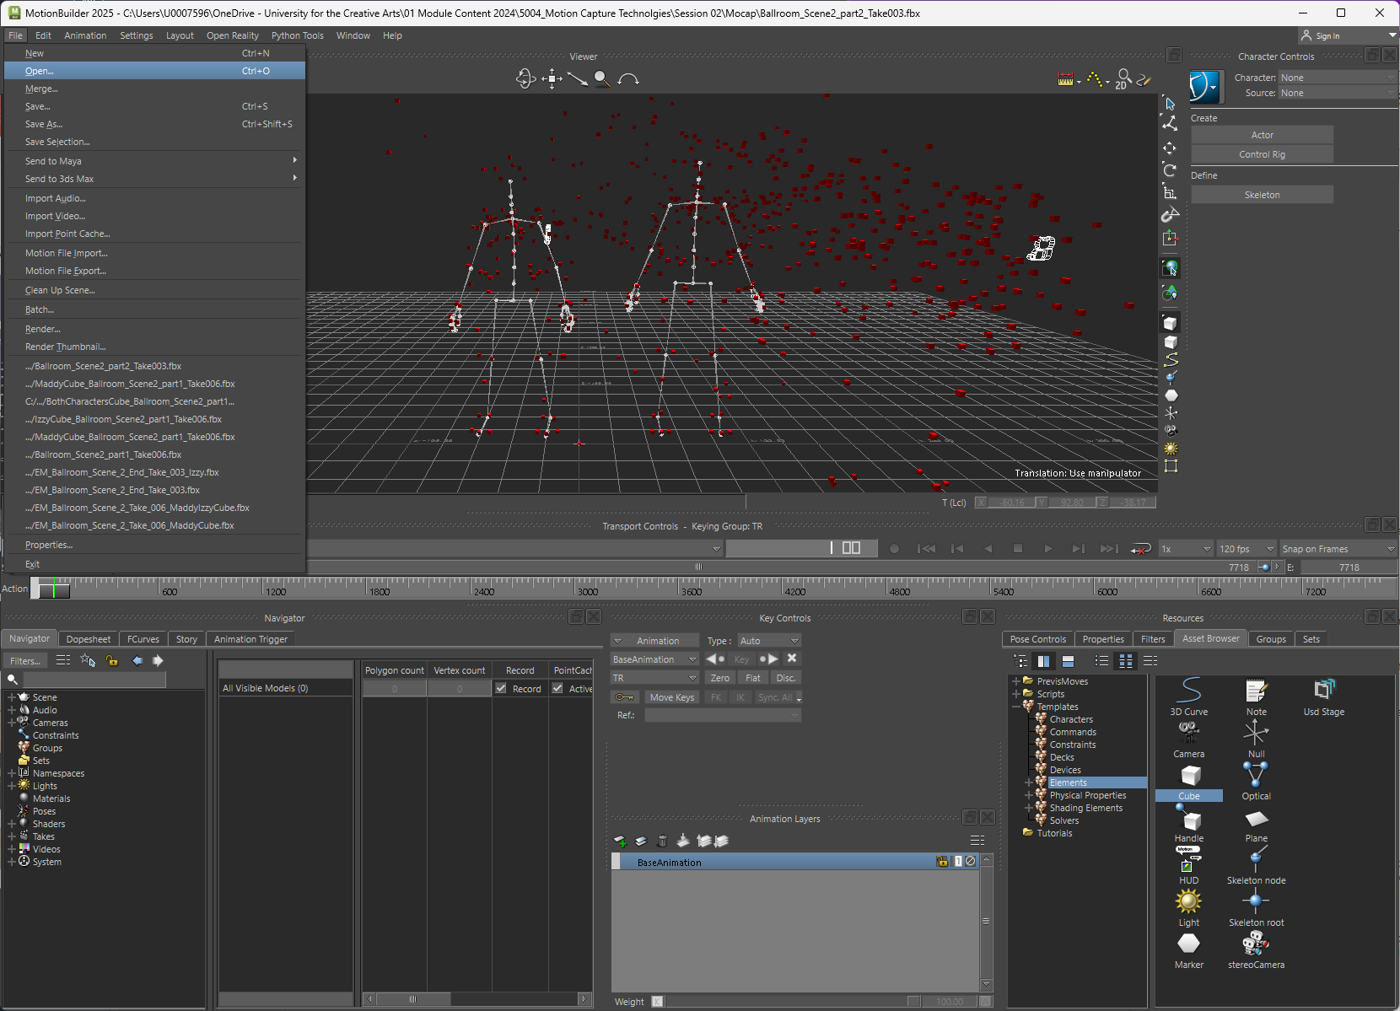

Preparing files
Open the file containing the additional animations for your character.

Slide 37
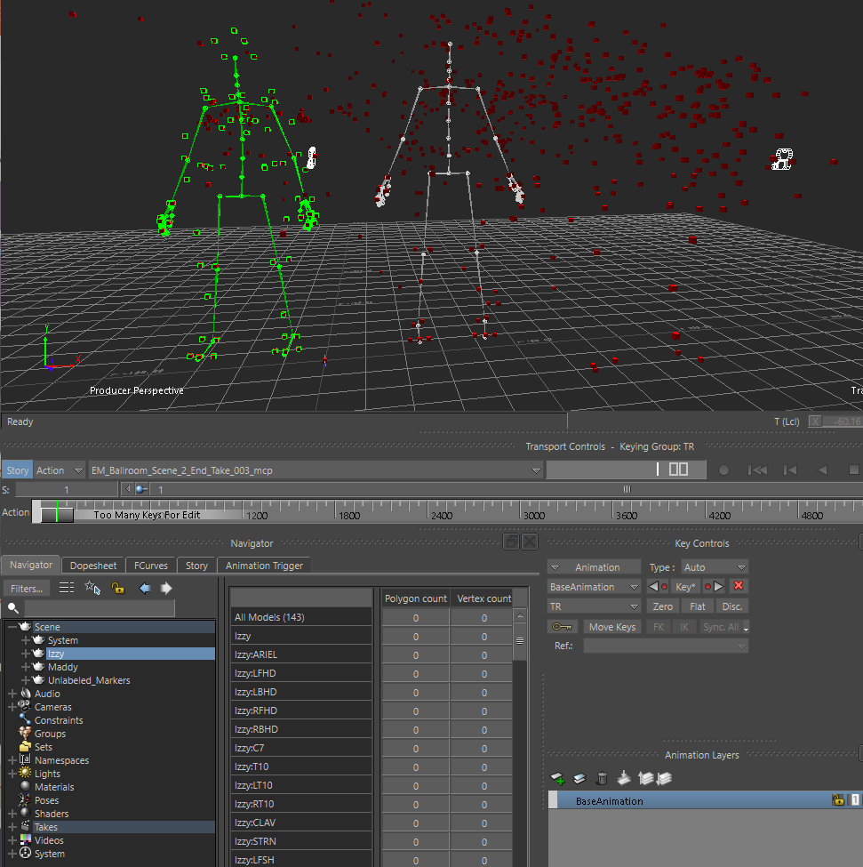
Preparing files
This time there is no need to clean the scene, or add the cube.
Simply, select the character you want to export (ie in the Navigator, select the top object, Right Click > Select Branches)

Slide 38
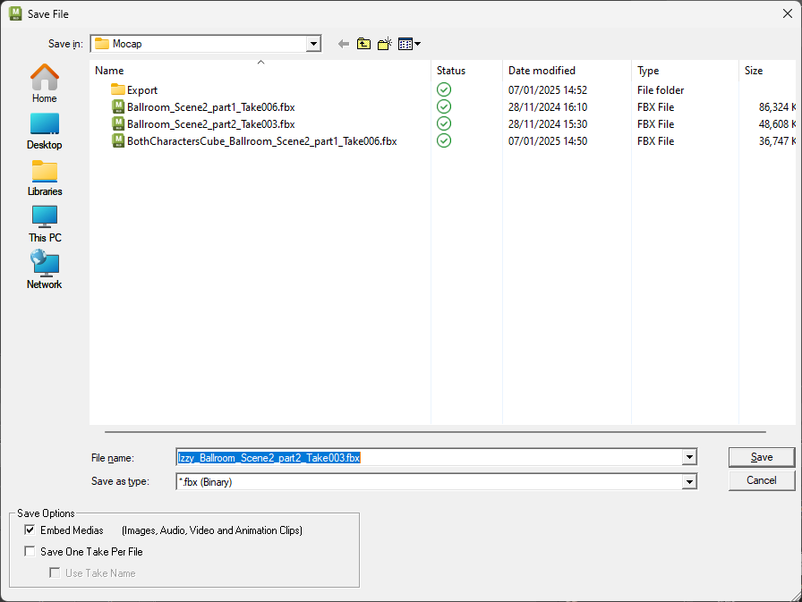
Exporting Characters
File > Save Selection…
Prefixing the name with:
CharacterName_

Slide 39
Importing mocap to Unreal

Slide 40
Note:
Again, the process is a bit different the first time you do this to any additional times.

Slide 41
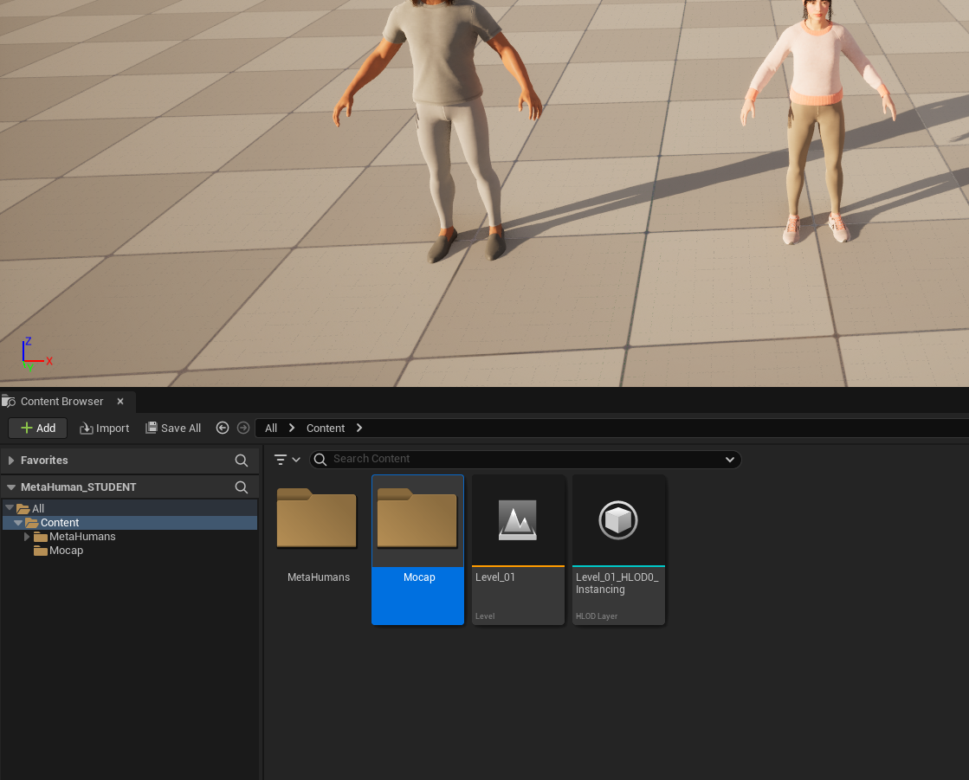
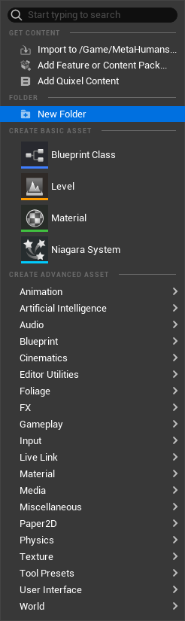
Importing Mocap
Create a new folder for the mocap files

Slide 42
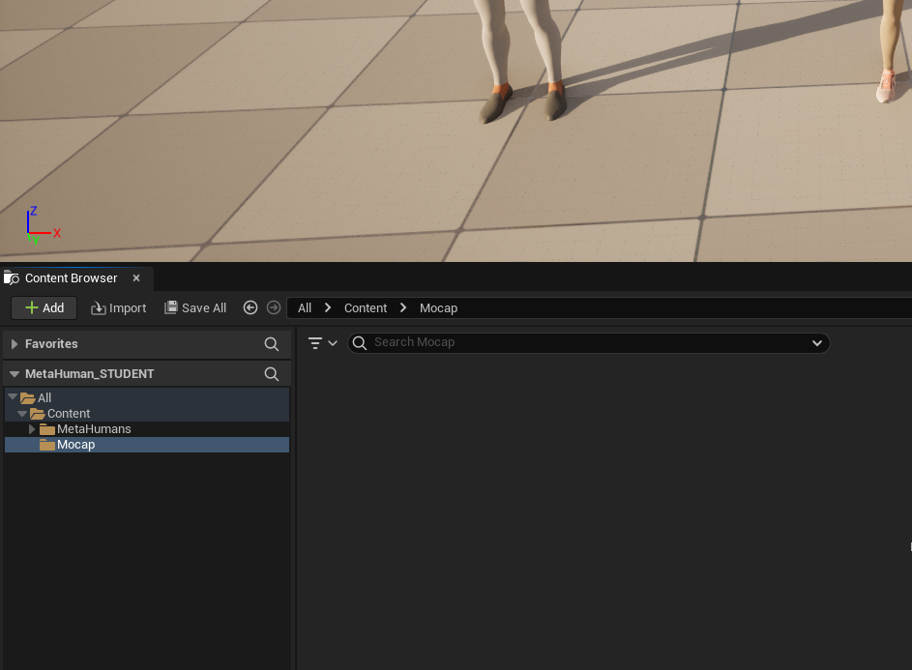
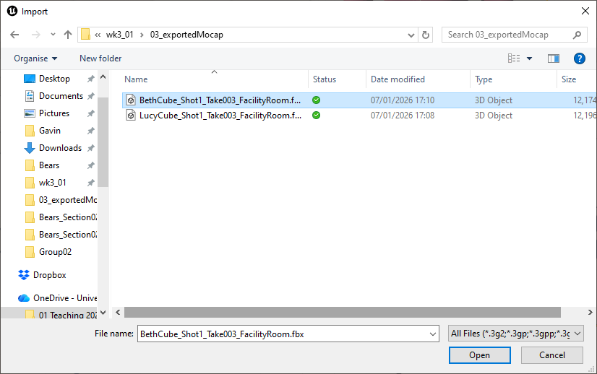
Importing Mocap

Slide 43
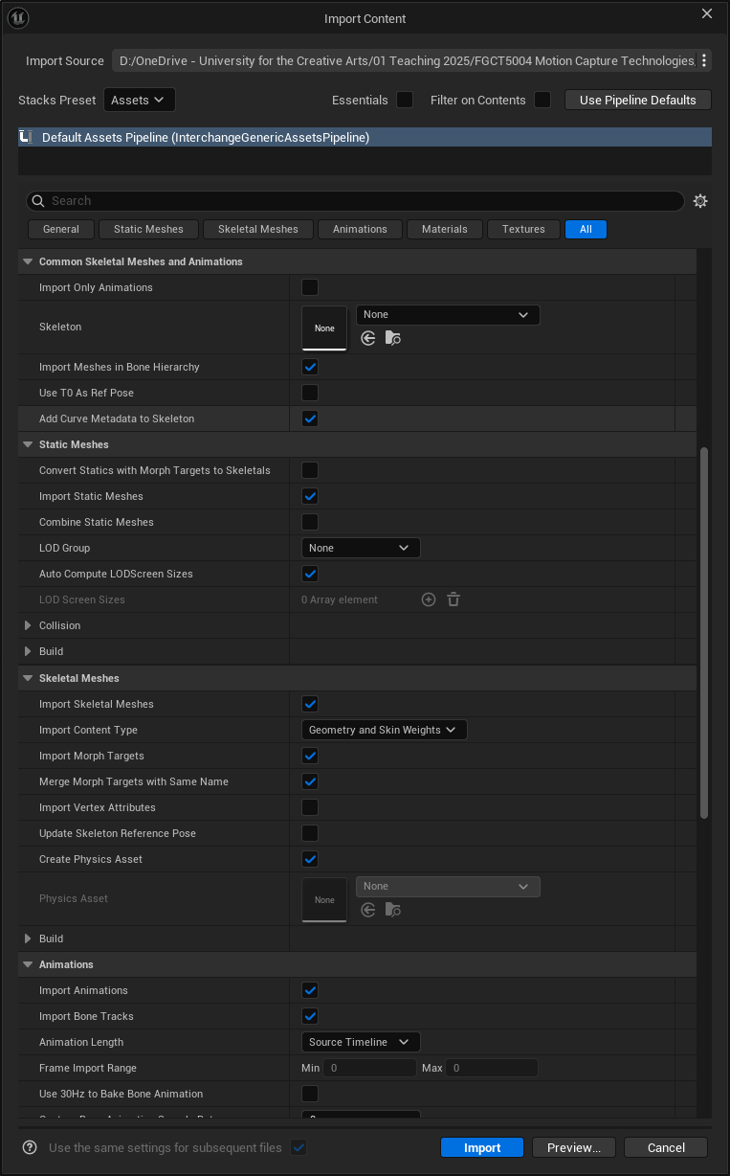
Import Options
You must deselect
Import Only Animations
(in the in the Common Skeletal Meshes and Animation section)
This should be set to None
(as your creating a new skeleton rather than assigning the animation to one already in your project)

Slide 44
Import Options
Make sure the Import Animation option is checked

Slide 45
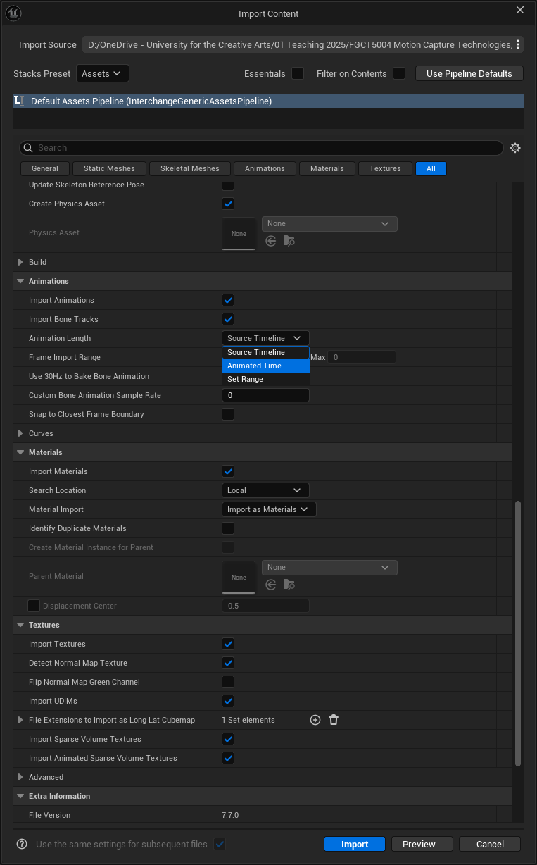
Import Error
If you get an error the first time you import the animation try setting the Animation Length to Animated Time, or if that does not work try Set Range

Slide 46
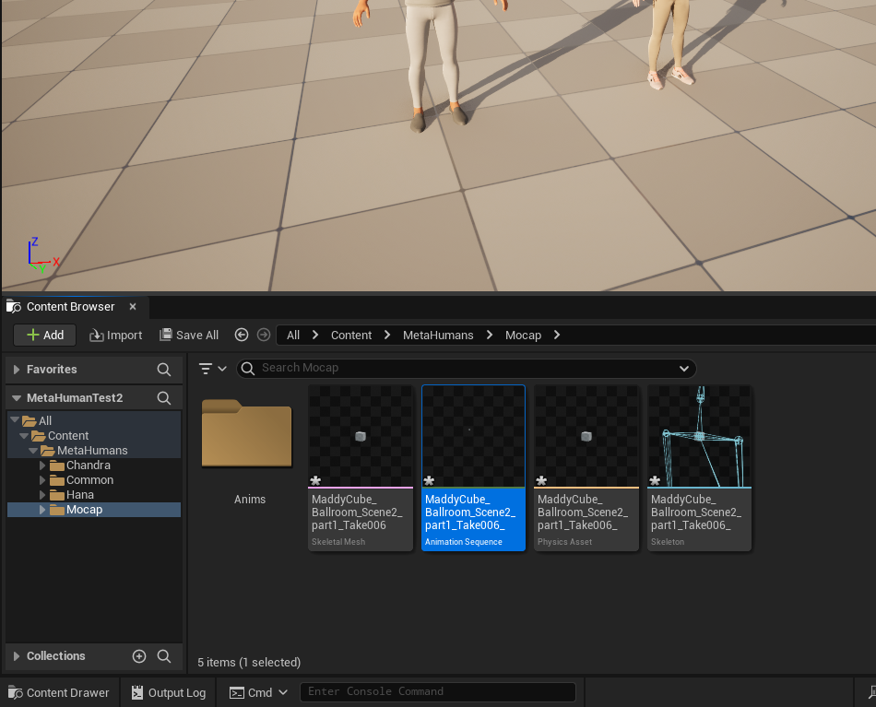
Importing Mocap
This is the Animation asset (the one saying Animation Sequence at bottom)
Let’s create a new folder for our animations and drag the animation asset into it

Slide 47

Importing other characters
When you try to import the mocap skeleton for another new character, you may find that Unreal tries to import it onto the previous skeleton that’s already been created.
You won’t want this to happen as you’ll want Unreal to create a brand new skeleton for your new mocap character, so within the skeleton dropdown you’ll need to press the clear button to set it to None

Slide 48
Importing mocap to Unreal
(Additional Animations)

Slide 49



Additional Animations
1
When importing additional animations for a character, we need to makes sure they are attached to the original skeleton we imported for that character. When importing:
Click on the dropdown in the Skeleton section.
Select the original skeleton you imported for that character (ie if you’re importing an animation for Maddy select the MaddyMesh…)

Slide 50
Retargeting Animations

Slide 51

Retarget Animations
First, we’ll need to know the name of our Metahuman’s Skeletal Mesh.
Within your character’s folder hierarch will be body folder, open this, then make a note of the name of the Skeletal Mesh asset.

Slide 52


Retarget Animations
Next, go to your animation assets (ie the imported mocap animation)
Right click, and select Retarget Animations

Slide 53


Retarget Animations
Original Skeleton (ie mocap Skeleton)
Right click and create a folder for your Retargeted Animations
Target Skeleton (ie MetaHuman Skeleton)
Animation to retarget (double click to get a preview)
Prefix the animation with the name of your MetaHuman

Slide 54
Sequencer

Slide 55


Sequencer
To create a new level sequence, right click in the Content Browser and pick Level Sequencer
Double click the new Level Sequence asset to open it.

Slide 56

Sequencer
In order to animate anything in the sequencer, you need to first add that object to the sequencer.
The easiest way to do this is to drag the object from the Outliner down to the left area of the sequencer

Slide 57


Sequencer
When we add a Metahuman to the sequencer it creates a ‘control rig’. However, we won’t be using these:
Select the Control rigs, and right click and delete.

Slide 58



Sequencer
To attach an animation:
Click the + next to the body
Select Animation
Pick the animation to attach
2
3
1

Slide 59


Master Sequence
A useful workflow can be to create a master sequence, ie a sequence that contains other sequences.
To do this create a brand new sequence, and within it create a Shot Track
Then click the + icon in the shot track to add a new shot (ie one of your previous sequences)

Slide 60
Master Sequence
A useful workflow can be to create a master sequence, ie a sequence that contains other sequences.
To do this create a brand new sequence, and within it create a Shot Track
Then click the + icon in the shot track to add a new shot (ie one of your previous sequences)

Slide 61
Other

Slide 62


Retarget Animations
Next, go to one of your animation assets (ie the mocap animation)
Right click, and select Retarget Animations
To set the startup map (ie the one that loads every time you start the project)

Slide 63

text
text
text
text
1
1
3
1
2

Slide 64

Title
Header title
Useful Stuff
University for the Creative Arts

